Slide 1

Investigate Business Hotel using Data Visualization
Created by:
Muhammad Cikal Merdeka
Email : mcikalmerdeka@gmail.com
LinkedIn : linkedin.com/in/mcikalmerdeka
Github : github.com/mcikalmerdeka
Dedicated entry-level data scientist with analytical and experimental background of Physics. My graduation 2023, a pivotal year marked by significant advancements in artificial intelligence with the introduction of GPT-4 and other generative AI models, has fueled my curiosity and excitement to delve into the field of data. I have comprehensive grasp of data science methodology from business understanding to modelling process with proficiency in Python, SQL, Tableau, Power BI, Looker Studio and other tools related to data analytics workflow from several coursework and bootcamps.

Slide 2
Impact Analysis of Stay Duration on Hotel Bookings Cancellation Rates
Apart from analyzing customer behavior in booking hotels, to measure the success of a hospitality business, we can look at the cancellation rate of bookings. If many customers cancel their bookings, it will negatively impact the hotel's performance. Therefore, we need to find out what factors influence booking cancellations. In this case, we will be focusing on the correlation of customer stay duration to hotel booking cancellation rates.
For more details, you can view the Jupyter notebook here.

Slide 3
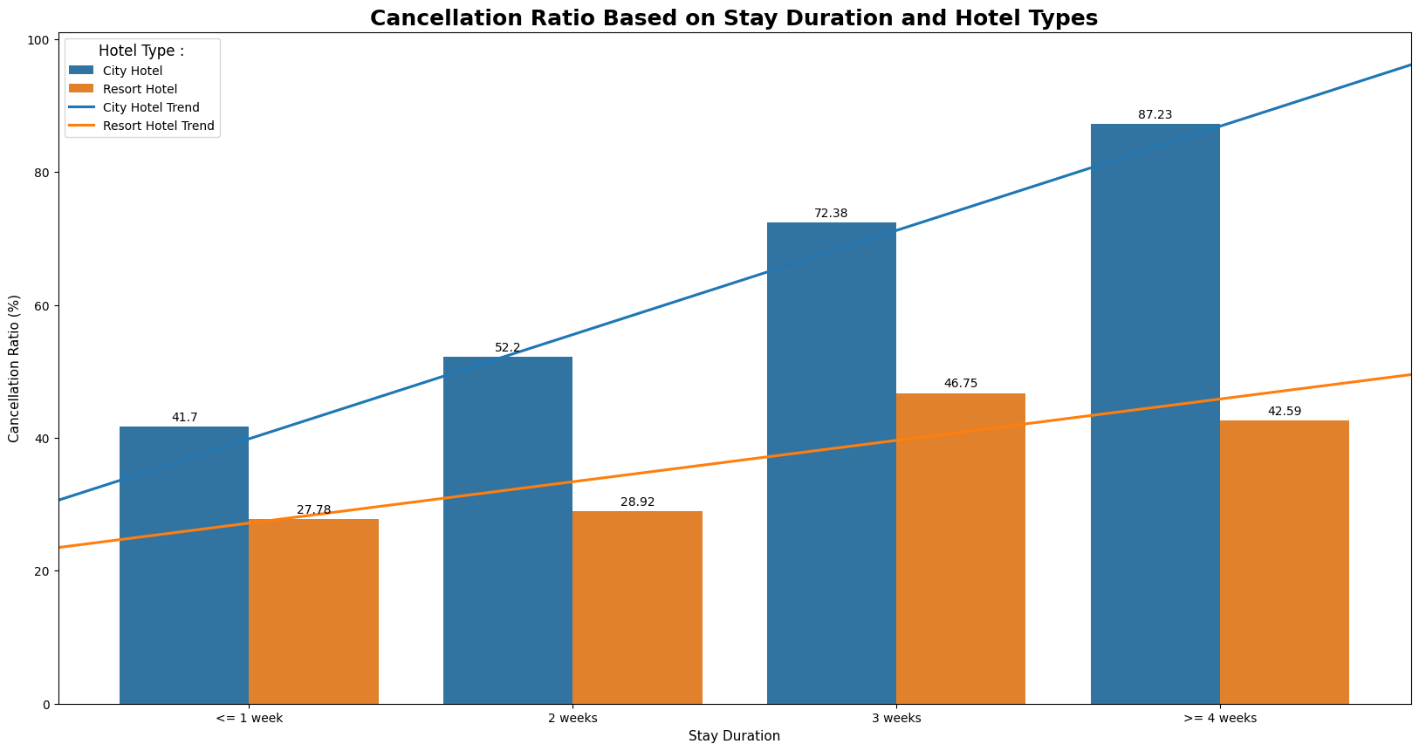
Impact Analysis of Stay Duration on Hotel Bookings Cancellation Rates
Data Visualization :

Slide 4
Impact Analysis of Stay Duration on Hotel Bookings Cancellation Rates
Data Interpretation and Business Recommendation :
The City Hotel has a higher total number of cancellations compared to the resort hotel overall, and with a more significant increasing trend. This suggests potential issues with customer satisfaction, booking management, or other factors specific to the City Hotel. To address this, the City Hotel management should focus on improving customer service, refining booking policies, and possibly implementing strategies to reduce cancellations, such as offering flexible booking options or enhancing the overall guest experience
There is a positive correlation between stay duration and cancellation rate, indicating that the longer customers stay, both in City and Resort Hotels, the higher the cancellation rate. This could be due to various reasons such as changes in travel plans, dissatisfaction with the hotel experience, or unforeseen circumstances. To mitigate this, both City and Resort Hotels can implement measures to incentivize longer stays, enhance the overall guest experience to minimize cancellations, and provide flexible cancellation policies to accommodate changing plans.

